Slide 1
Worlds Together
Contact , Colonization and its Consequences: Focus on the Americas

Slide 2
Housekeeping
First Primary source assignment goes live today. Due, via BB Learn by February 16th
All submission deadline times, for all assignments, are @ start of class!
InQuizitive: If there are grade discrepancy issues, between what you scored and what comes on the grade sheet, please submit a support ticket: https://support.wwnorton.com/request

Slide 3
Plan: This slide set used for BOTH today’s class and the next one
Your Questions
After that, my focus today will be
1. To very briefly go over the sections on post-pandemic Ming China and Europe that we could not cover last time
2. Move to the readings for this module, where I will emphasize :
Reasons for maritime exploration, east and west, and,
The societies in place in the Americas at the time of contact
Will not spend time on processes of conquest, alliances, etc. That is well covered by readings. I will bring in specifics in the context of discussing some themes
Implications and consequences of contact (Columbian Exchange) to be covered in the next lecture

Slide 4
Reminder
I may not always spend time on events described in textbook
Lectures are not a summary, class meetings are a location where:
I explain connections, bring together events as part of a narrative
Add some information
Sometimes, where we undertake some group work
A place where I try to address your queries
That is why no real substitute for being in class, and engaging with the material during class time

Slide 5
Ming China
Mongols and the Black Death led the way for the emergence of the Ming dynasty
Famine and the Black Death devastated China; some cities = 90% death toll
Yuan, Mongol, rulers faced chaos and dissent
Zhu, an orphan from a peasant household, founded the Ming (“brilliant”) dynasty in 1368
Ming rulers faced the formidable challenges of rebuilding cities, restoring respect for rulers, and reconstructing the bureaucracy
Built the 13,000 mile long Great Wall of China, the Forbidden City complex in Beijing, and an extravagant capital at Nanjing
Extensive use of gunpowder, including mounting cannon on ships
Notes:
The most prominent challenge to Mongol rulers, the Red Turban Movement, blended Buddhism, Daoism, and other philosophies with strict practices involving diet, penance, and ceremonies in which the sexes freely mixed and wore red headbands. Red Turban Commander Zhu Yuanzhang started driving Mongols from China beginning with Nanjing in 1356.

Slide 6
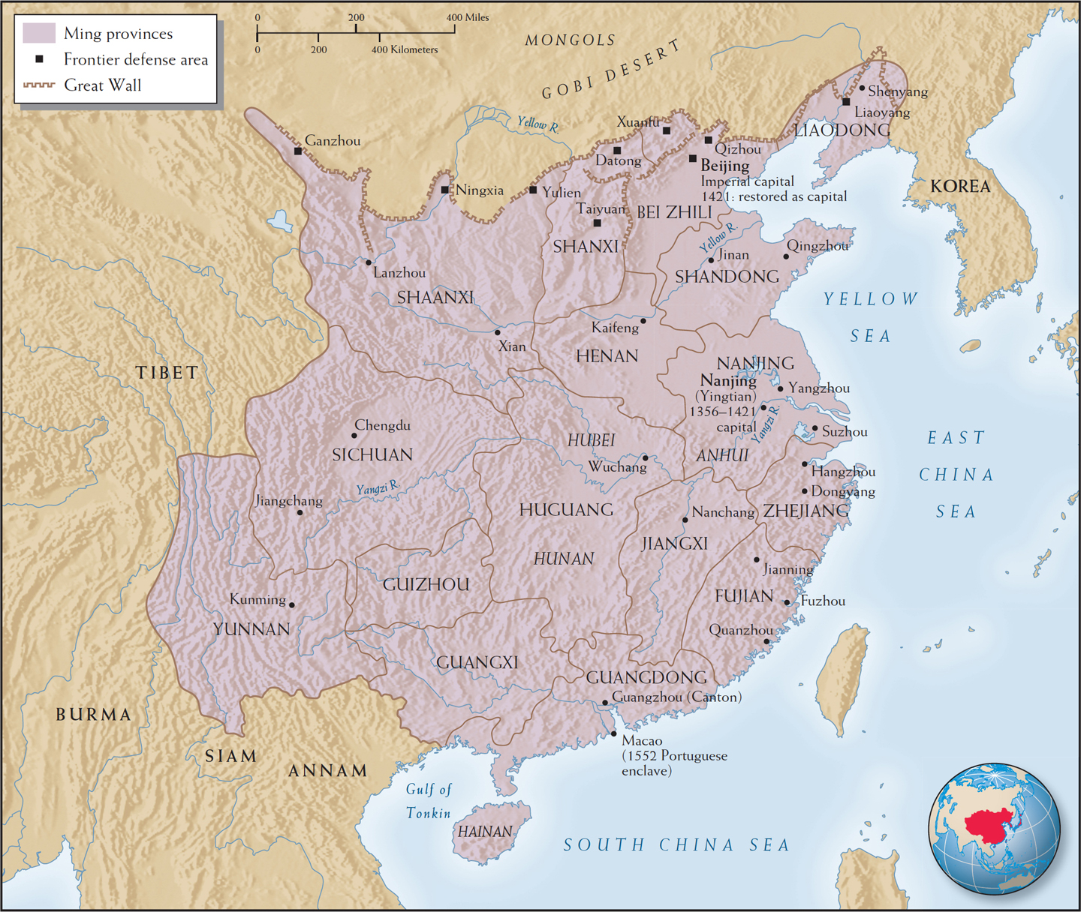
Ming China, 1500s
WORLDS TOGETHER, WORLDS APART, 5TH EDITION
© 2018 W. W. Norton & Co., Inc.
Notes:
Map 11.6 | Ming China, 1500s
The Ming state was one of the largest empires at this time—and the most populous. It had a long seacoast and even longer internal borders.
• What were the two Ming capitals, and what were the three main seaport trading cities?
• According to the map, where did the Ming rulers expect the greatest threat to their security?
• From your reading, how did the Ming rulers view foreign contact and exchange during this period?

Slide 7
Trade and Exploration in Ming China
Overseas trade often regarded with suspicion
Because of China’s own massive domestic market state not need to sponsor explorations like European states
Emperor Yongle’s sponsorship of a series of expeditions in the early fifteenth century was an exception to Ming attitudes toward the outside world, but did lead to…
From 1405 to 1433, Admiral Zheng He, who led seven expeditions in the Indian Ocean to establish trade and tributary relationships
Decades before either Columbus or Vasco da Gama
The man who mapped the world. Undertook seven voyages
Traveled to South-east Asia, Persian Gulf, Red Sea, eastern Africa— Zanzibar , made a voyage to Mecca
https://www.youtube.com/watch?v=cjWscQolTK4
Although exotic and glamorous goods delighted the court, they were not everyday commerce, and Ming rulers withdrew imperial support for expensive maritime trade
Concerns about military threats from the north led to increased attention to overland ventures and defense

Slide 8
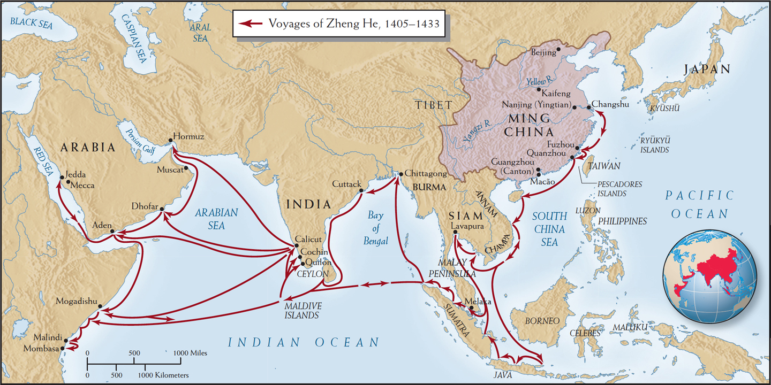
Voyages of Zheng He, 1405–1433
WORLDS TOGETHER, WORLDS APART, 5TH EDITION
© 2018 W. W. Norton & Co., Inc.
Notes:
Map 11.7 | Voyages of Zheng He, 1405–1433
Zheng He’s voyages are some of the most famous in world history. Many historians have speculated about how history might have been different if the Chinese emperors had allowed the voyages to continue.
• For how many years did Zheng’s voyages last?
• How far did Zheng’s voyages take him?
• Why did Chinese expeditions not have the same impact as European voyages of exploration toward the end of the fifteenth century?

Slide 9
Zheng He and Columbus’ ships

Slide 10
Europe
The plague in Europe
The plague killed nearly two-thirds of Europe’s population from 1346 to 1353
Cities were especially vulnerable, because they were overcrowded and unsanitary
By 1450, Europe’s population had fallen to one-quarter of its previous size
Church, in response:
Struggled to reclaim its power as it faced challenges from officials and laity
Increased persecution of heretics, Jews, Muslims, homosexuals, prostitutes, and “witches”
Expanded its charity, giving alms to the poor
Saw large-scale peasant revolts
Jacquerie in 1358: French peasants revolted and went on a rampage against nobles and clergy
English Peasants’ Revolt in 1381

Slide 11
Governments
Increase in state power in monarchies such as Hapsburgs. In France, England, Spain, Portugal, e.g., the power of local (feudal) lords was surpassed by new “national monarchies”
In other locations, Italian City States e.g., the wealthy selected their leaders
“Reconquista” of the Iberian peninsula and The Inquisition
In 1481, the Inquisition targeted conversos, or recently converted Jews and Muslims
After the fall of Granada in 1492, the monarchs ordered all Jews and some Moors, half a million people, out of Spain
Some European economies grew with expansion of trade with Asia
Spanish Monarchs gave their royal support to a Genoese navigator, Christopher Columbus, who promised them unimaginable wealth
In northern Europe, the lack of access to trade networks added to political instability

Slide 12
The Renaissance and Political Power in Europe
Western Europe had lost knowledge of ancient Greek or Rome. Flight of Armenian scholars from Constantinople after Ottoman conquest made this knowledge available to them
Scholars at Universitas had been struggling to cope with new circumstances. The availability of older knowledge led to “a dive backward” into traditions of ancient Greece and Rome. Humanism aspired to know more about the human experience beyond what the Christian scriptures offered
Led to what was termed a “Renaissance” (revival) in arts and ideas
Not always appreciated, either by Church or all political leaders
Moving around made Europe’s Renaissance elites more cosmopolitan (as it had in China and the Islamic empires). Scholars met one another in different locations and formed a “republic of letters”—a network of seekers of knowledge, creating a trans-European intellectual elite
New ideas had real world applications in statecraft and military technology
The Renaissance also gave a network of educated men and women the means to challenge political, clerical, and aesthetic authority
Florentines pioneered a form of civic humanism under which all citizens were to devote themselves to ensuring liberty
Deploying both ancient ideas and this-worldly power, the Renaissance revolutionized both European culture and politics
Notes:
The Renaissance revolutionized European society by creating a culture of cosmopolitan critics who sought classical ideas to address the challenges of an expanding world.

Slide 13
Lecture FEBRUARY 7th Housekeeping
1. Quiz ONE, drawing from Chapters 10, 11, 12 opened today
As “study guide” please use “Review Quizzes” for the relevant chapters
For Quiz One, all the questions will be drawn from the Review Quizzes for Chapters 10, 11, and 12
2. PRIMARY SOURCE evaluation assignment has been live since last Thu DUE Thu Feb 16th
3. Do see the short 6 minute documentary film in addition to readings for Feb 9th

Slide 14
WORLDS TOGETHER
1400-1600 era saw eastern and western hemispheres connected–worlds apart moving to worlds coming together
Cannot call it an age of “discovery”
Indian subcontinent had maritime connections with Afro Eurasia since start of Common Era, if not a couple of millennia prior to that. No “discovery” there
Americas had rich, prosperous empires
Population of Aztec and Inca empires together ca. 1500 = ~ 18 million
Population of Spain ca. 1500 = ~ 8 million
Who “discovered” whom?
But a historically a momentous occurrence: historians are still debating how best to label this. A Conquest? An Invasion? A Collision? Or simply an Encounter?
On one point though, historians are agree. This hemispheric contact inaugurated a system of global inequality (more on that later!)
The arrival of Spaniards and Portuguese also began one of the most profound and extensive changes in the history of human-kind. From 1500-1850: about 10-15 million Africans and about 5 million Europeans crossed the Atlantic and settled into the Americas–as part of a great migratory global movement

Slide 15
What do the Ottomans have to do with this?
Not the Renaissance, that they did too (classical texts travel to W. Europe) but the Age of European EXPLORATION?
Ottoman empire expanding
conquests of Constantinople (1453) and Athens (1458) in West
of Egypt and Syria (1516–1517) in east
Effectively control (therefore block) trading routes to the riches of Asia
THAT is a one big reason why European kingdoms like Portugal and Spain begin exploring Atlantic coast of Africa, and later their attempts to find new routes to South and East Asia
The Spanish supported Columbus’s explorations to Asia, with new sea routes to the west, Portuguese sponsor Vasco da Gama traveling east

Slide 16
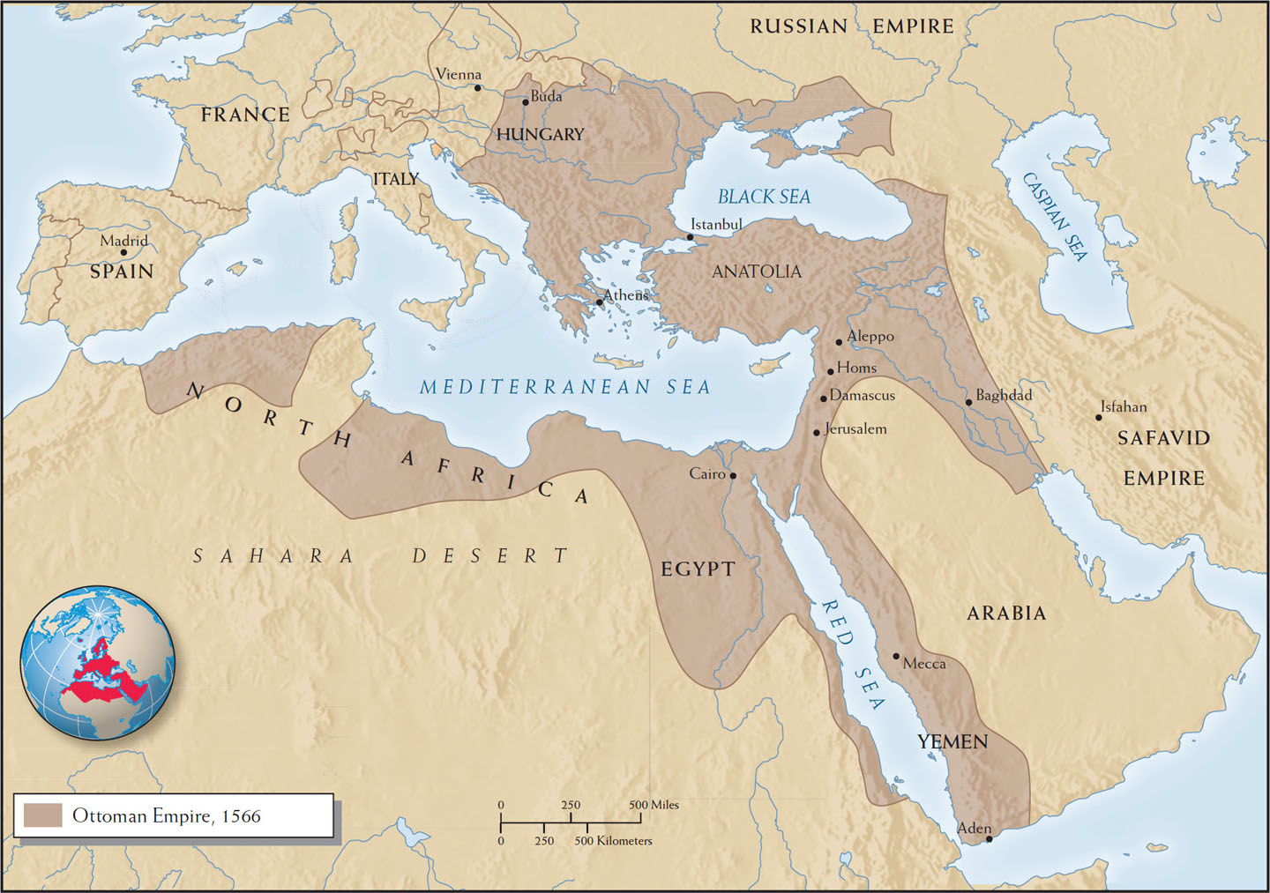
The Ottoman Empire at the Middle of the Sixteenth Century
WORLDS TOGETHER, WORLDS APART, 5TH EDITION
© 2018 W. W. Norton & Co., Inc.
Notes:
Map 12.1 | The Ottoman Empire at the Middle of the Sixteenth Century
This map shows the expansive area controlled by the Ottoman Empire by the middle of the sixteenth century. Note the very close proximity of the Ottoman borders to the Habsburg capital of Vienna.
• What territories did the Ottomans add to their empire in the sixteenth century?
• Why did they aspire to take over Vienna, and why did they fail?
• Was the Ottoman Empire reaching its outermost limits?
• Why did the Ottomans venture so aggressively into the Red Sea and the Indian Ocean in the sixteenth century?

Slide 17
Colonizing the Ocean!
Vasco da Gama was the first European mariner to reach India in 1498, due to the skills of a Arab and Indian traders who had crossed the Indian Ocean for centuries
da Gama pretty brutal and abrasive, willing to fight for commercial access and roughed up everyone he met
Returned to Portugal making a huge profit, to great honor, but with less than half of his ship’s crew
The Portuguese took control of strategic key ports in the Indian Ocean, East Africa, West Asia, South Asia, and China, such as Aden, Hormuz, Melaka, Sofala, Kilwa, Goa, Calicut, and Macao
The Portuguese asserted their Indian Ocean supremacy by enforcing a pass system, or cartaz, like a toll fee or a protection racket!
Lisbon eclipsed Italian ports as the prime entry point for Asian goods into Europe

Slide 18
How controlling ports such as Hormuz, Aden, Kilwa, Sofala, Goa, Calicut, Melaka,and Macao allowed control over Indian Ocean

Slide 19
Spices, Guns, and Souls
Portuguese and Spanish were drawn by desire to profit from commodities such as spices, silks, and slaves, as well as the potential to attract new converts to Christianity
Gunpowder cannon technologies benefited larger, centralized states that could afford them; for example:
In 1415, English defeated the French in the Battle of Agincourt
In 1453, Ottomans defeated the Byzantines at Constantinople
In 1492, Spanish defeated the Moors, with the fall of Granada
Borrowed military technologies from Asia, such as Chinese gunpowder, also contributed to Portuguese success in the Indian Ocean

Slide 20
The Atlantic World
The development of new Atlantic sea lanes began an epochal transformation in world history
Europeans were able to conquer and colonize the Americas, unlike Africa or Asia, because of diseases such as smallpox, typhus, and cholera, which decimated Amerindian populations
“Atlantic Ocean system” emerged and enriched Europeans, as Europeans transported African slave labor to the Americas in numbers far greater than European migrants
This accidental discovery led to conquest and great wealth for Europeans
The term “New World” reflects the European view that this land was “new” because it was previously unknown to them

Slide 21
Christopher Columbus
Originally from Genoa (now in Italy), Columbus persuaded the Spanish royalty to sponsor efforts to find a Westward route to India
October 12, 1492, Columbus reached San Salvador in the Bahamas and ushered in a new era of world history
First encounters
Columbus’s first encounters with Tainos in the Caribbean symbolized European contrasting images of Amerindians as innocents or savages
Columbus mislabeled Tainos as “Indians,” as he believed he had reached India
Described the Tainos as a child-like people with no religion, ready for conversion, but in possession of some gold
We know less about Taino perceptions of Europeans
On behalf of Spain, Columbus claimed the island of Hispaniola (today, Haiti, and the Dominican Republic), his tales of gold prompted more expeditions

Slide 22
First Conquests
The Spanish experimented with colonial rule, creating
a model in Hispaniola for the rest of the New World
Spaniards faced Indian resistance
Spaniards responded by enslaving Indians to work in gold mines
The Spanish crown awarded encomiendas (grants) to the encomenderos (settlers with the right to coerce or force Indian labor), although they had to pay special taxes on precious metals extracted from their land
When the island’s Indian labor and gold supply dwindled, many Spaniards looked for opportunity elsewhere
That is what brought Europeans into contact with the two rich and vibrant empires of mainland Americas, the Aztecs in Mesoamerica and the Incas in South America

Slide 23
To John Green and Crash Course!
https://www.youtube.com/watch?v=rjhIzemLdos
:45 to 2:00 Aztec
2:53 to 3:45 Inca
4:18 to 5:20 Changing Labor forms

Slide 24
THE AZTEC EMPIRE
Agrarian based Mesoamerican empire, advanced skills in agriculture and building, spoke Nahuatl
Each village selected a representative council who sent delegates to select the chief speaker or the Aztec emperor
The emperor was not supreme but negotiated power between religious and military leaders
Priesthood important, politically and socially
Practiced human-sacrifice—mainly sacrificed conquered people to propitiate the gods
In school children taught to read and write but also rituals of war—a militaristic culture
Established their capital in Tenochtitlan: present day Mexico

Slide 25
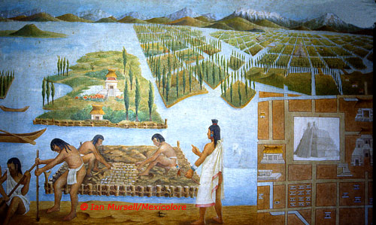
Innovative Agricultural farms: Chinampas
Floating farms made artificially on lakes: filled it with mud and decaying vegetation—very fertile farm lands and provided good food resources for a growing population.

Slide 26
TENOCHTITLAN: “Large House”
Europeans called it the “VENICE” Of Americas
This was the Aztec capital and the religious center of the empire.
2. 200, 000 people lived in this city at the time of Spanish conquest
3. Cortes and his men on seeing this—thought it was not real, that they were dreaming—1519-1520

Slide 27
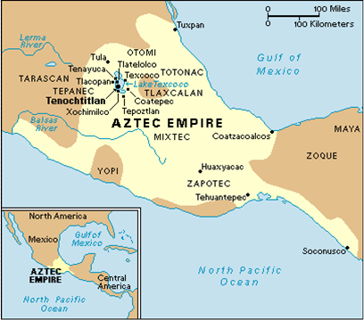

Slide 28
Aztec Conquest
The Aztec Empire spread and sustained through conquest and the creation of tributary states, bringing with them great wealth but also military instability
From 1440 onward, the Aztec Empire was under stress because of constant rebellions and a large military with divisions among elites
The Spaniards were able to conquer the powerful Aztecs because
The Spanish formed alliances with Aztec enemies such as the Tlaxcalans (Doña Marina, a noble from the Tabasco region whose people resisted Aztec domination was another ally)
Aztec warfare involved capturing enemies, while Spanish warfare consisted of killing enemies
Aztecs were not familiar with European technology such as cannons, gunpowder, steel swords, horses, and war dogs
Moctezuma allowed Cortés to enter the city of Tenochtitlan
In 1519, Cortés captured Tenochtitlan and held Moctezuma hostage, allowing Cortés to rule through him

Slide 29
INCAS
Geographical location: up and down the Andes—covered present-day Peru and Chile
Large empire: 4-6 million people with a their capital Cuzco—in present day Peru
Internal trade up and down the Andes, used Llamas and Alpaca, who provided meat, wool, fertilizer and were the main beast of burden—sure footed on a hilly terrain
Worshipped a sun god—Inti— the emperor a “child of the sun”
Major Inca achievements:
Beautiful pottery and weaving
Genius found in statecraft and architecture—built stone buildings, irrigational projects, and very impressive road systems and bridges
Machu Picchu—world heritage site:

Slide 30
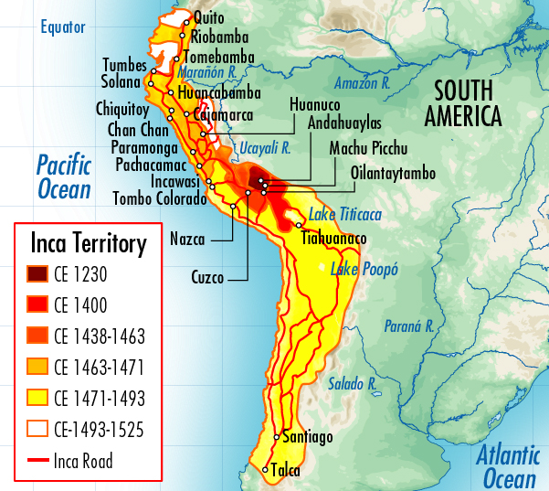

Slide 31
MACHU PICCHU

Slide 32
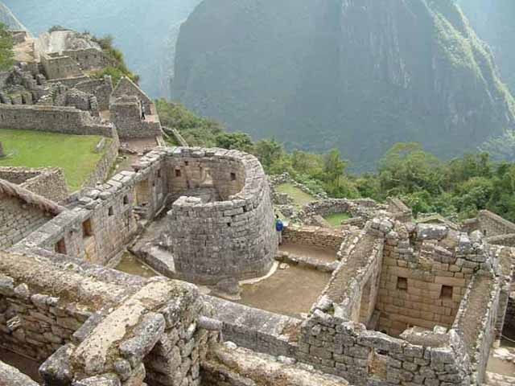

Slide 33
Inca rope bridges: used local grass

Slide 34
Inca Conquest
Before the Spanish arrived, a smallpox epidemic spread from Mesoamerica into the Andes, resulting in the premature death of the Inca emperor
In 1532, Francisco Pizarro with his 600 men, horses, and dogs laid a trap and defeated the emperor’s son Atahualpa and his men
The Spanish arrived in large numbers to stake their claims for encomiendas to their new capital of Lima
The European defeat of the New World’s two great empires, the Aztecs and Incas, introduced a new scale of imperial expansion and provided Europe with great wealth and a market for their products

Slide 35
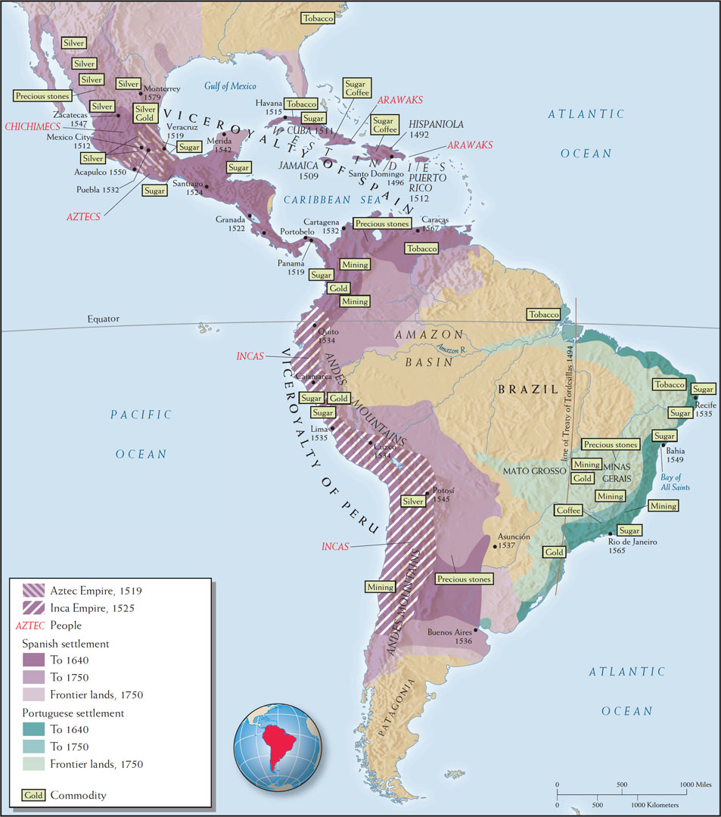
The Spanish and Portuguese Empires in the Americas, 1492–1750
WORLDS TOGETHER, WORLDS APART, 5TH EDITION
© 2018 W. W. Norton & Co., Inc.
Notes:
Map 12.6 | The Spanish and Portuguese Empires in the Americas, 1492–1750
This map examines the growth of the Spanish and Portuguese Empires in the Americas over two and a half centuries.
• Identify the natural resources that led the Spaniards and Portuguese to focus their empire building where they did.
• What were the major export commodities from these colonized areas?
• Looking back to Map 12.2, why do you think Spanish settlement covered so much more area than Portuguese settlement?
• According to your reading, how did the production and export of silver and sugar shape the labor systems that evolved in both empires?

Slide 36
Impacts: Changing Forms of Labor
Labor was demanded of the population in both Aztec and Inca empires called the Mit’a System among Incas. People required to provide labor to poor and weak members of the society and to the Emperor’s fields. Compulsory but it was not slave labor, each person was assigned a certain number of required days of labor service
The Spanish tapped into existing networks for the organization of labor and tribute systems, not completely dismantling indigenous empires
They created the encomienda, which built on previous Aztec and Inca labor conscription systems
In the Spanish POTOSI silver mines e.g.—families were required to send their men to work and if they died, they were required to be replaced

Slide 37
Impacts: Mestizaje
Very few Spanish women emigrated to the Americas, and indigenous women worked as domestic servants, mistresses, nurses, caretakers, advisers, and even joint rulers
Spanish men took indigenous women as concubines
Some Spaniards married into prominent indigenous families, in continuation of local forms of dynastic rule
As a result, mestizos became the fastest-growing population in Spanish America
Most Spaniards and their children lived in towns, and the former imperial cities of Mexico City and Cuzco flourished

Slide 38
Columbian Exchange: Commerce and Colonization in the Atlantic World
Environmental consequences of the conquest
The Columbian Exchange transformed the environments, economies, and diets of both the New and Old Worlds
European diseases such as smallpox, measles, pneumonic plague, and influenza decimated 90 percent of the Amerindian population
New forms of agricultural exchanges
From the New World spread corn, tomatoes, beans, cacao, peanuts, tobacco, and squash
From the Old World came grains, sorghum, millet, rice, cattle, and sheep
Ecological imperialism—the flora and fauna of the Americas took on an increasingly European appearance as vegetation was cleared to make way for ranches, mines, or plantations

Slide 39
Global Impact: Population
Indigenous populations in some regions (Caribbean islands e.g.) were almost completely wiped out. Others in the new world significantly reduced
Thanks to the calories made available through the Columbian Exchange though, population of the Afro Eurasian world almost DOUBLED between 1650 and 1850

Slide 40
Global Impact: Silver
From Potosí (present-day Bolivia) and northern Mexico, massive amounts of silver (25,000–35,000 tons annually) sent to Spain
New world silver became the “entry ticket” of western Europe into global trading networks
Led to intensive exploitation of indigenous labor; reorganized to support mining ventures
Accumulation of private wealth led to formation of powerful local elites in Mexico and Andean areas
Silver became principal medium of exchange in expanding global markets
Impact of “new world” silver was to have a profound impact in the economic history of the entire world, fueling global inflation on account of the sudden massive influx of silver (more on this next week)

Slide 41
Extracting Wealth
Gold and silver from the New World (the Americas) to the Old World (Afro-Eurasia) transformed global relations
Inspired by Spanish and Portuguese financial success, other European powers also launched colonizing ventures in the New World
Where they could not find gold or silver, they cultivated sugar cane, cotton, tobacco, indigo, and rice using AFRICAN SLAVES
They inexpensively produced wild fur and pelts prized in Europe
Sugar transformed the European diet as Europeans imported 12 million tons of sugar between 1690 and 1790, or one ton (2,000 pounds) for every African slave
Tooth decay became a leading cause of death for Europeans

Slide 42
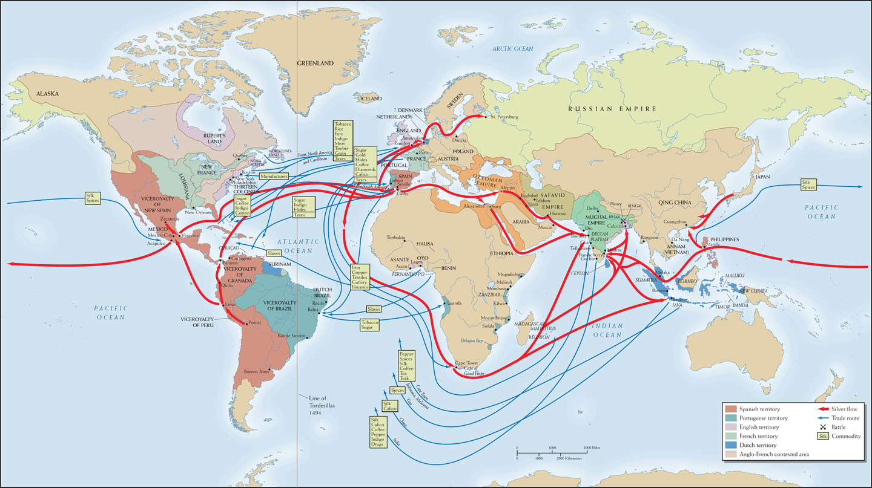
Trade in Silver and Other Commodities, 1650–1750
WORLDS TOGETHER, WORLDS APART, 5TH EDITION
© 2018 W. W. Norton & Co., Inc.
Notes:
Map 13.1 | Trade in Silver and Other Commodities, 1650–1750
The seventeenth and eighteenth centuries were the first centuries of true global commerce. Silver was the one item that was traded all over the world.
• Can you trace the flows of silver from the Americas around the globe (by following the thick red arrows) and identify the commodities that silver was exchanged for in different parts of the world?
• Does the map provide enough information for you to conclude which of these global empires was the wealthiest and most powerful?
• According to this map, how did increased trade shape European states’ territorial ambitions?

Slide 43
Extracting Wealth: Mercantilism
A new economic theory, mercantilism, drove European imperialism
This doctrine presumed that the world’s wealth was fixed and that one country’s wealth came at another’s expense
It assumed that colonies existed to generate wealth for the motherland
Colonies were forbidden to trade with the motherland’s competitors
Mercantilists believed the philosophy of Thomas Hobbes (1588–1679): “Wealth is power and power is wealth”
The mercantilist system required an alliance between the state and its merchants, embodied in chartered companies such as the English Virginia Company and the Dutch East India Company

Slide 44
Conclusion, Part 1
In the middle of the fifteenth century, Europe was poor compared to the rest of the world
In the process of searching for Asian goods and enabled by technological innovations, Europeans started sailing to Africa, across the Indian Ocean, and across the Atlantic, accidentally encountering the Americas, a “discovery” of monumental significance
New sources of portable wealth in the form of silver and gold, new Atlantic systems, control over indigenous labor, and alliances with local elites afforded Europeans greater influence in Asia and the Americas and expanded opportunities for exchange, conquest, and colonization

Slide 45
Conclusion, Part 2
Two conquests—the Ottoman conquest of Constantinople (because it motivated Europeans to find new links to Asia) and the Spanish conquest of the Aztec and Inca—characterize this age of increasing and intensifying interconnection
Europeans exploited Native American labor and resources and exploited African laborers as slaves
The new oceanic system, the Atlantic system, created an imperial and colonial link transforming Africa, America, and Europe

Slide 46
(if there is time) Vasco da Gama Primary Source: Questions for Breakout Groups
• Can we tell what da Gama expected to find when landed in Calicut?
• What does the document reveal of his motives for the journey?
• Why do you think da Gama mistook Hindus for Christians? Think of the only religion he knew of other than Christianity.
• What does this account tell us of the relative economic positions of Europe and Asia at the end of the 15th Century?
5 minute breakout group. Return and Discuss

